Slide 1
Pass-the-hash Attack in Microsoft’s active directory
Notes:
Hello, our project studied solutions on how to prevent a Pass-the-Hash Attack in Microsoft’s Active Directory (Slide 1) (Daniel)

Slide 2
Introduction to group
Daniel Rusev – Informational Technology Senior at Lewis University
Roles: Project Manager, Researcher, Tester, and Developer
Solution Focus: Detection Pipeline
Hamza Khan - Informational Technology Senior at Lewis University
Roles: Researcher, Tester, and Developer
Solution Focus: Mitigation Practices
Notes:
Hi, my name is Daniel Rusev. I am a senior at Lewis University studying Informational Technology.
My roles in this project are being the project manager, as well as being a researcher, tester, and developer.
My solution focused on creating a detection pipeline that detects PtH attack behaviors (Daniel).

Slide 3
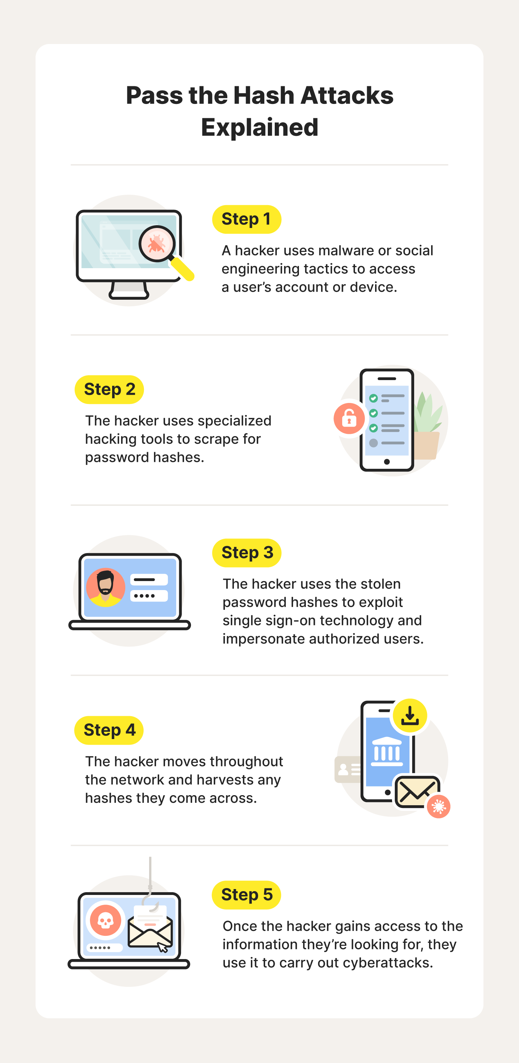
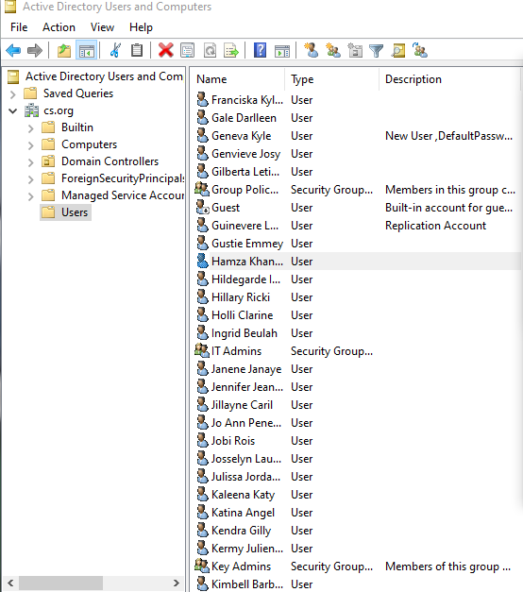
Problem
Active Directory (AD) is widely used to manage user identities, user privileges, and network resources, but is very vulnerable to Pass-the-Hash (PtH) attacks.
Image Source: us-stage.norton.com
Notes:
Active Directory (AD) is widely used to manage user identities, user privileges, and network resources. Users authenticate to the Domain Controller by using NTLM hashes to verify a user’s identity without revealing a plaintext password during initial communication between a user device and the Domain Controller. However, this method of authentication leaves AD servers vulnerable to Pass-the-Hash (PtH) attacks. (Slide 3) (Daniel)
Next Hamza slide 4 – 5 - 6

Slide 4
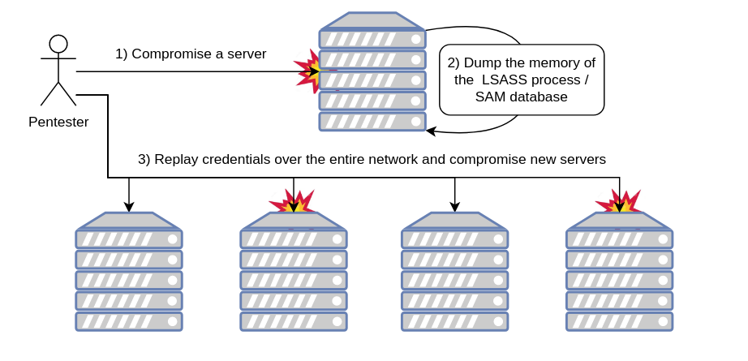
Key Vulnerability – LSASS Process
Image Source: sensepost.com
Notes:
PtH attacks allow adversaries to reuse stolen NTLM hashes to impersonate as domain users. This is due to the key vulnerability of the Active Directory caching its user’s NTLM hashes in the LSASS process of local user devices. Attackers can compromise the LSASS process by extracting credentials through using extraction tools like Mimikatz or Metasploit’s Kiwi tool. (Slide 4) (Daniel)
Once an attacker authenticates using a stolen hash, they can escalate user privileges and laterally move across the network to compromise other user accounts or other sectors of the network (Slide 4) (Daniel).

Slide 5
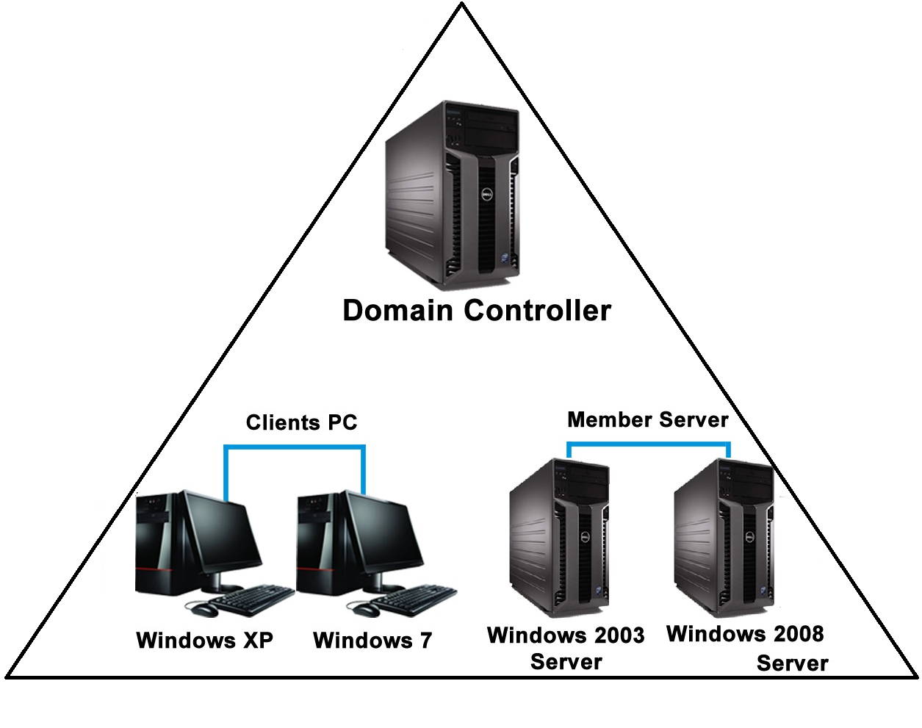
target – domain controller
Image Source: ashwaqjaved.blogspot.com
Notes:
Most notably an attacker aims to move laterally towards the Domain Controller which holds all of the AD’s data such as their users’ personal data. (Slide 5) (Hamza)

Slide 6
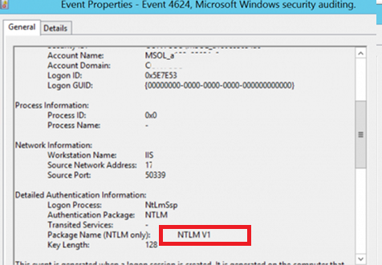
Successful Logon Event (4624)
Typically uses an NTLM authentication method to logon
Image Source: woshub.com
Notes:
Limited native monitoring makes PtH difficult to detect without enhanced logging. This is due to the attack’s ability to mimic a legitimate user authentication. Native Windows event logs display an event ID of 4624, which indicates a successful logon event. These events are generated multiple times a day by normal users authenticating to the Domain Controller using their own NTLM hashes, which allows an attacker who authenticated through passing a stolen hash to go completely under the radar. (Slide 6) (Hamza)

Slide 7
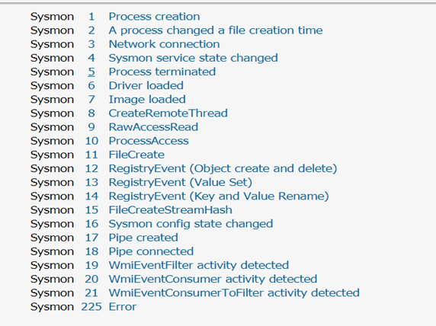
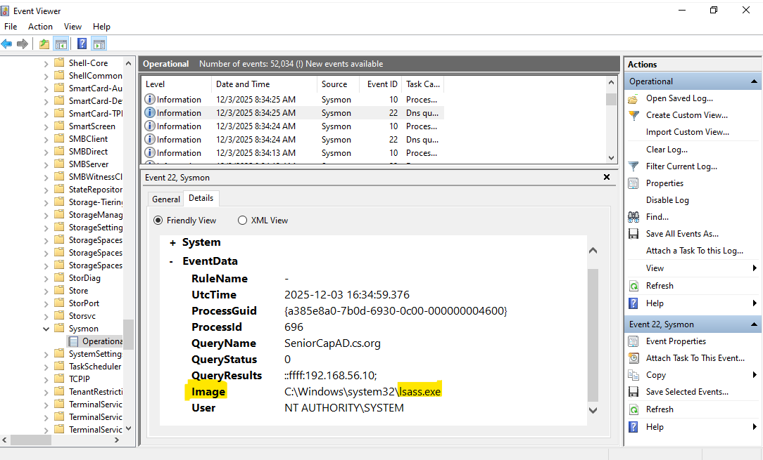
Solution 1
Detect Specific PtH Attack Behaviors Using Sysmon and Wazuh
Image Source: crossrealms.github.io
Detected LSASS process creation in image path
Identified with Event ID 10 (Process Access)
Notes:
In our research we developed two solutions that aim to secure an Active Directory from a Pass-the-Hash attack. In our first solution, we employed open-source detection tools to detect and alert specific behaviors associated with a Pass-the-Hash attack.
Specifically, we deployed Sysmon and Wazuh agents on Windows endpoints to collect high-fidelity event logs that detect the attack’s behaviors. Sysmon is a tool that provides enhanced event logs that provide specific details of the event that occurred. Here we can see that Sysmon breaks each event down into specific categories such as process creation, network connection, and image loading events. Sysmon leverages these specific categories to produce detailed logs that show where this event originated from, what files or processes have been executed, and what commands have been executed. This example here shows a generate Sysmon log that detected an image that contained the use of the LSASS process that came from IP address 192.168.56.10, with an event ID of 10, indicating the LSASS process was accessed to extract credentials. (Slide 7)

Slide 8
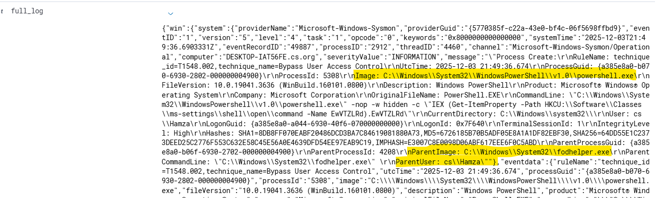
Full Sysmon logs are sent to Wazuh
Displays that the event sourced from fodhelper.exe execution in user Hamza’s PowerShell
Notes:
When a specific behavior is detected, Sysmon forwards these logs to the Wazuh manager for processing, and Wazuh will then analyze these logs to identify the severity of the event, what caused this event to occur, and the appropriate rule to trigger to generate an alert for a potential security incident. In this example, we have the full Sysmon log that was sent to the Wazuh server after the fodhelper process was created. Wazuh analyzed this log to identify that the event originated from user Hamza’s account, and used the Windows PowerShell to create the fodhelper process (Slide 8).

Slide 9
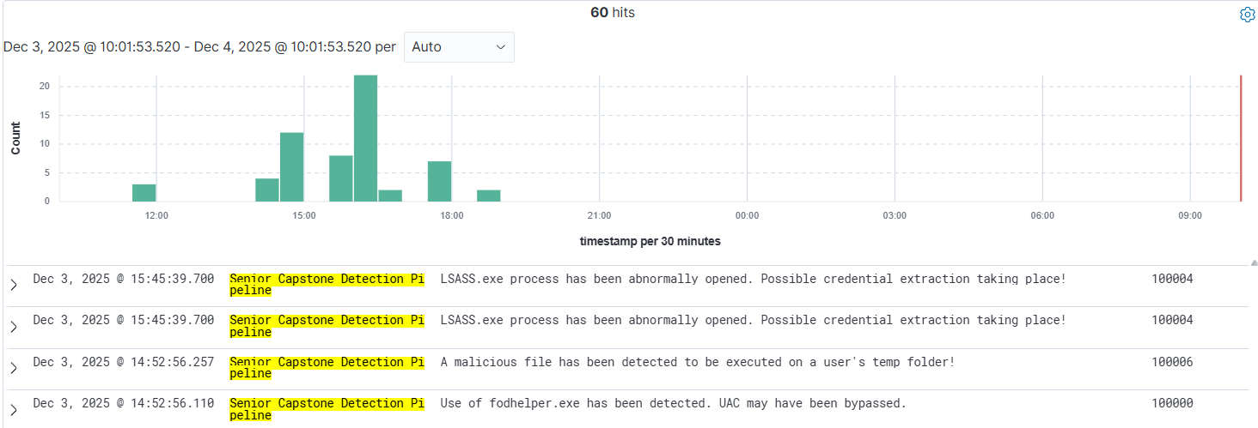
Rules triggered after analyzing Sysmon event logs
Notes:
After identifying what caused the event, Wazuh will generate a real-time alert from one of its rules list to be displayed on the dashboard for a security analyst to view. (Slide 9)

Slide 10
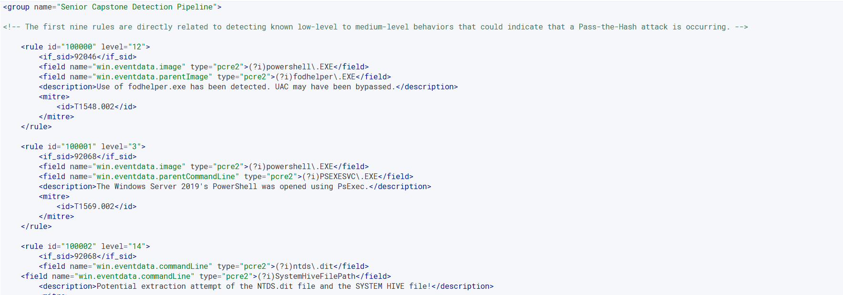
Wazuh custom atomic rules
Triggers when specific PtH behaviors are detected
Notes:
In our project we wrote custom rules that will detect specific Pass-the-Hash behaviors we have observed during our test simulations (Slide 10), (Go to slide 11)

Slide 11
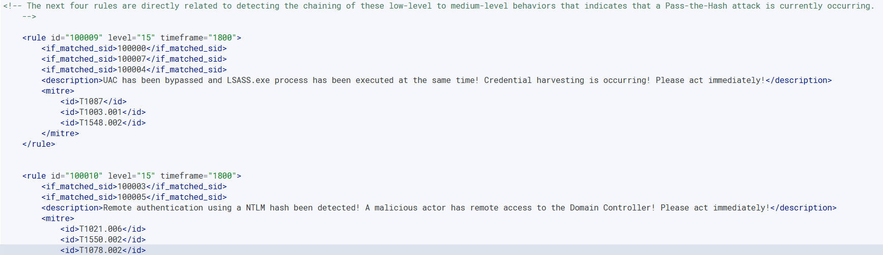
Wazuh custom correlation rules
Triggers when specific events are chained together
Notes:
as well as rules to detect the chaining of events that indicate a specific attack procedure we performed during our simulation. (Slide 11).
Next Hamza slide 12 - 14

Slide 12
Solution: Implement Mitigation Practices
Notes:
Speaker Notes:
Our solution consisted of two main components: First, we built a dedicated detection pipeline using Sysmon for endpoint monitoring and Wazuh for event aggregation and alerting. This allowed us to identify key behaviors associated with Pass-the-Hash, such as remote authentication and hash-based process execution. Second, we implemented mitigation controls to limit credential reuse. LAPS rotated local admin credentials, preventing attackers from reusing captured hashes. Enforcing NTLMv2 improved authentication security, and reducing privileges limited attack paths. Together, these controls helped reduce the success of PtH attacks in our environment.

Slide 13
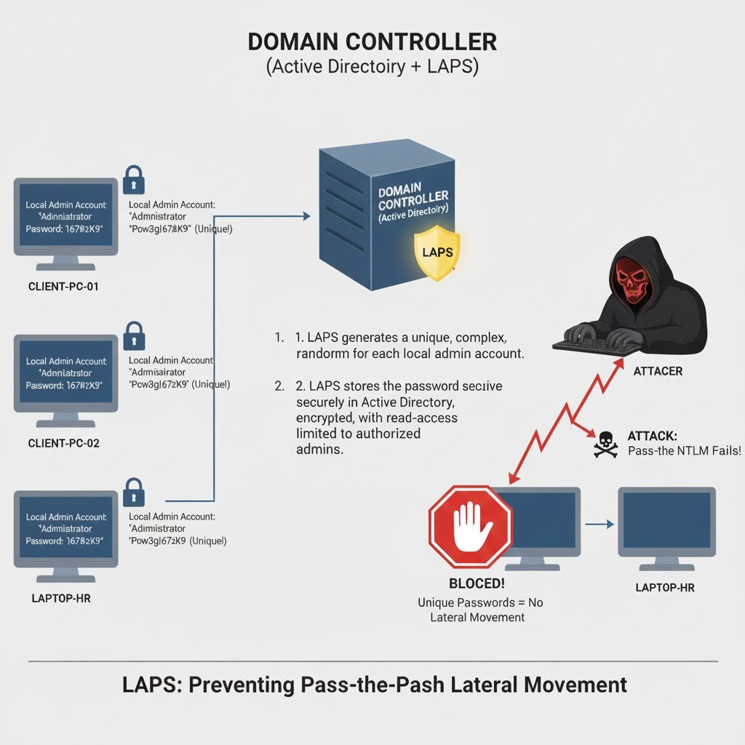
Solution 1
LAPS automatically creates and stores a unique local administrator password for each domain-joined computer.
Reduces attack surface by removing shared credentials.
What
How
Why
Security impact
Attack Prevention
Best Practices
Microsoft, “AI-generated image,” Bing Image Creator, 2025.
Notes:
Speaker Notes:
Our solution consisted of two main components: First, we built a dedicated detection pipeline using Sysmon for endpoint monitoring and Wazuh for event aggregation and alerting. This allowed us to identify key behaviors associated with Pass-the-Hash, such as remote authentication and hash-based process execution. Second, we implemented mitigation controls to limit credential reuse. LAPS rotated local admin credentials, preventing attackers from reusing captured hashes. Enforcing NTLMv2 improved authentication security, and reducing privileges limited attack paths. Together, these controls helped reduce the success of PtH attacks in our environment.

Slide 14
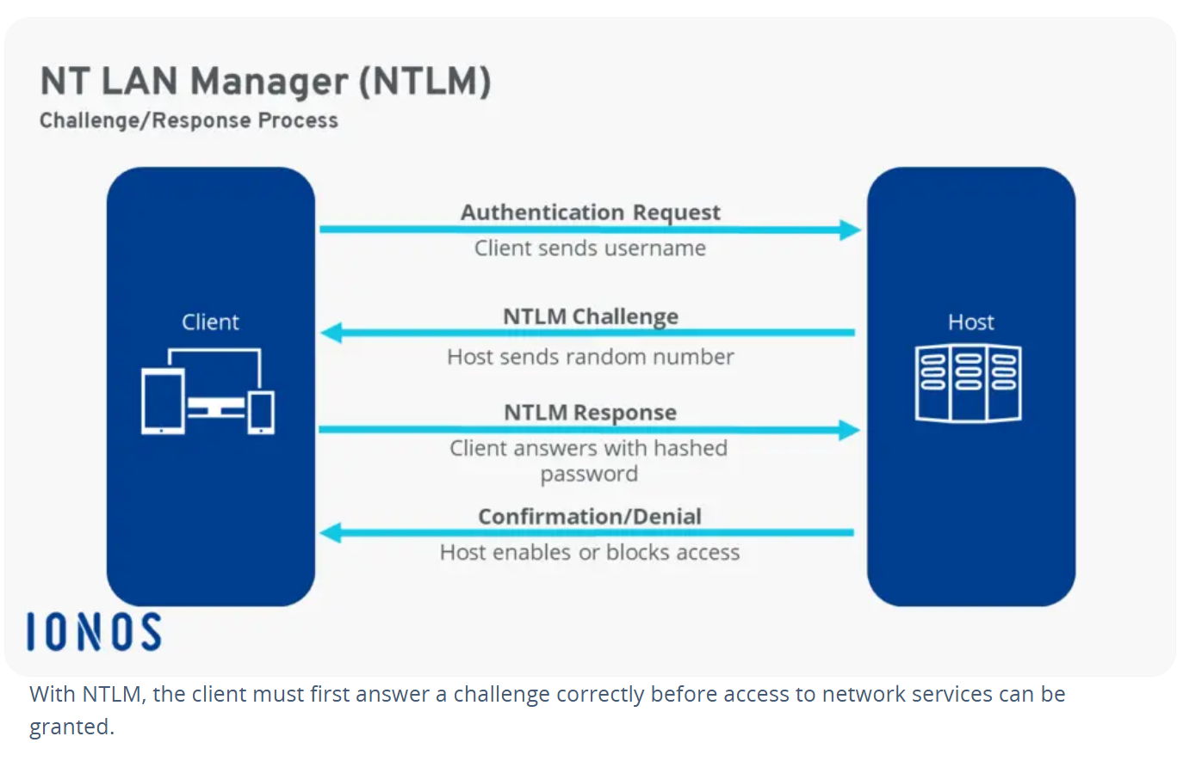
Solution 2
NTLMv2 is Microsoft’s stronger authentication method used for Windows logins.
Strengthens authentication across the entire domain.
What
How
Why
Security impact
Attack Prevention
Best Practices
Notes:
Speaker Notes:
Our solution consisted of two main components: First, we built a dedicated detection pipeline using Sysmon for endpoint monitoring and Wazuh for event aggregation and alerting. This allowed us to identify key behaviors associated with Pass-the-Hash, such as remote authentication and hash-based process execution. Second, we implemented mitigation controls to limit credential reuse. LAPS rotated local admin credentials, preventing attackers from reusing captured hashes. Enforcing NTLMv2 improved authentication security, and reducing privileges limited attack paths. Together, these controls helped reduce the success of PtH attacks in our environment.

Slide 15
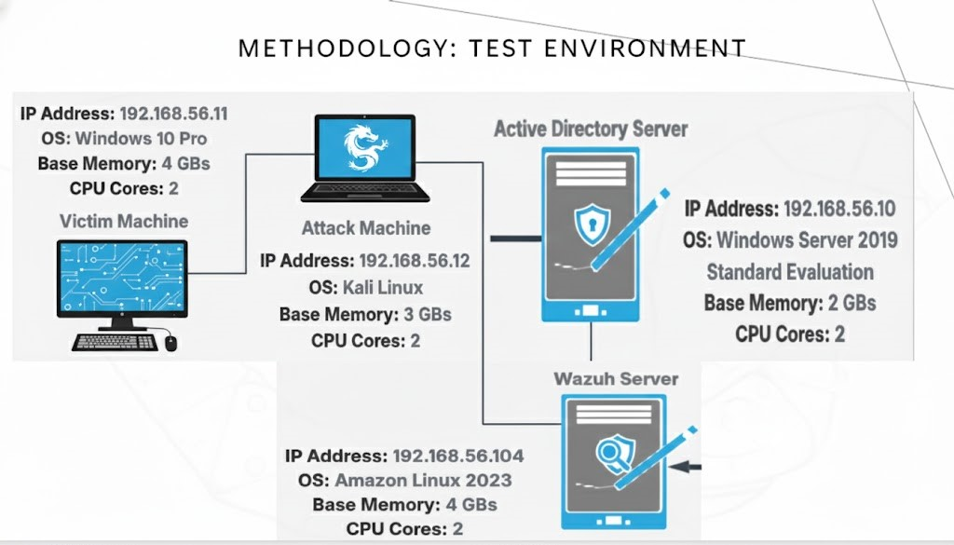
Notes:
We first built a test environment that contains a Windows 10 Pro machine, a Kali Linux machine, a Windows Server 2019 machine, and a Wazuh server. (Slide 15)(Daniel)
Our Kali Linux machine acts as our attack machine. Kali Linux is built with several penetration tools that are designed to perform reconnaissance of the network, scan for vulnerable IP addresses to target, and compromise vulnerable machines to gain unauthorized access to. (Slide 15)(Daniel)
Our Windows 10 Pro machine acts as our victim machine. We configured this machine with security vulnerabilities such as turning off domain and private network firewalls, and disabling real-time protection. This is to allow for the download and deployment of our malicious payload that grants the Kali Linux machine access to the Windows 10 machine. (Slide 15)(Daniel)
Our Windows Server 2019 machine holds the Active Directory and the Domain Controller server. This machine is also configured with known vulnerabilities such as disabled firewalls to allow for remote connect to the Domain Controller, and the storing of NTLM hashes on its local devices’ LSASS memory after a user authenticates to the domain. (Slide 15)(Daniel)
Finally, our Wazuh server collects Sysmon logs from both the Windows 10 Pro machine and the Windows Server 2019, and houses the GUI that shows a dashboard of all triggered alerts. (Slide 15)(Daniel)

Slide 16
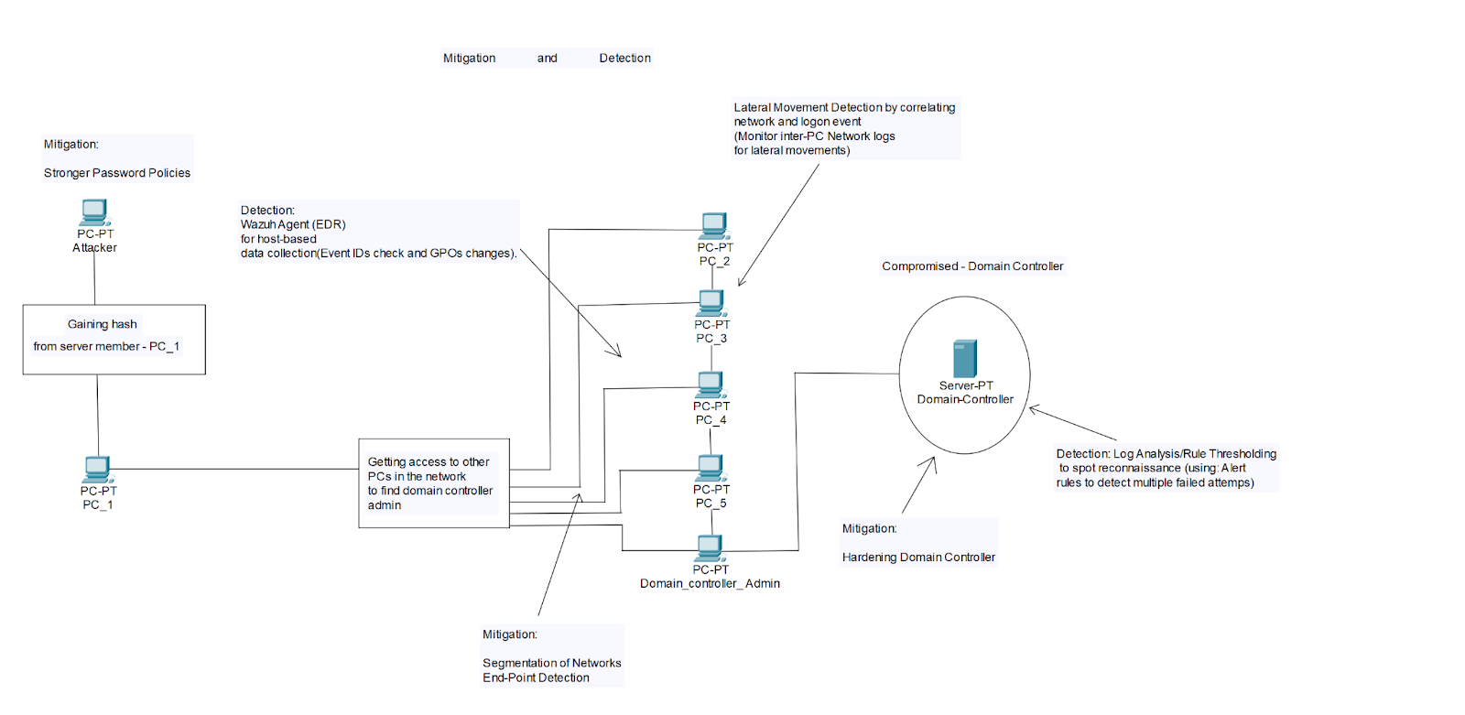
Full Lab Architecture
Notes:
Each machine is connected through an isolated network in the 192.168.56.0/24 range for private and isolated communication between only these devices, ensuring that the machines cannot communicate directly with the internet or any other external network, and isolating the attack into only this environment. (Slide 16)(Daniel)
Next Hamza slide 17 - 18

Slide 17
Methodology: Attack simulation
Four Stages of Attack
Reconnaissance
Obtaining Remote Access
Compromising a NTLM Hash
Compromising the Domain Controller
CS
Notes:
We broke down the simulation of our attack into four stages. Our end goal is to compromise an account with administrator privileges to gain unauthorized access to the Domain Controller to extract the ntds.dit file that contains all of the AD’s data. (Hamza) (Slide 17)

Slide 18
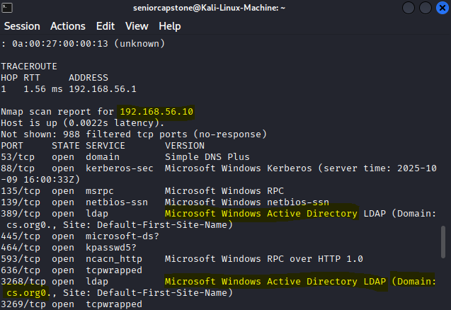
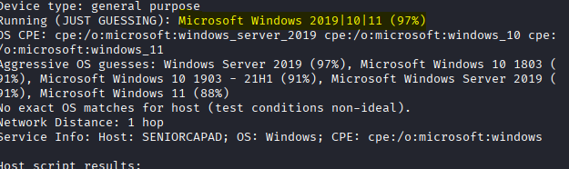
Stage 1: Reconnaissance
Scanned local network with Nmap tool
Discovered IP addresses 192.168.56.10 and 192.168.56.11
192.168.56.10 contains an AD server
IP address 192.168.56.10 is discovered to be running Windows Server 2019 OS
CS
Notes:
Stage One: We first simulated network reconnaissance using Kali Linux’s Nmap tool to reveal target IP addresses, their open ports, and the operating system they are running. We revealed two IP addresses. The first one is 192.168.56.10. The scan revealed that is machine is hosting a Windows Server 2019 OS, and has the LDAP protocol open, revealing that this machine is hosting an Active Directory server named “cs.org” . The next IP address revealed in the network was a Windows 10 Pro machine, heavily indicating that it is a domain machine part of the “cs.org” domain. (Hamza) (Slide 18)

Slide 19
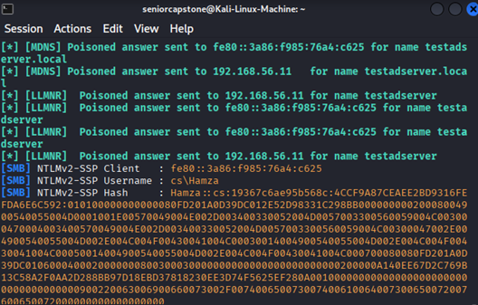
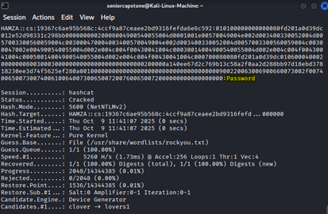
Stage 1: Reconnaissance
Responder revealed local username and password hash
Cracked password
CS
Notes:
Stage One: We then needed to see if the domain network had credential guard disabled, to see if it was possible to extract a standard domain user’s NTLM hash from the target machine’s LSASS process. We used the Responder tool to send out a poisoned answer to the IP address of the Windows 10 Pro machine, and simulated a credential popup on the target machine by typing in “\\TestADServer” in the address bar of the File Explorer app. This resulted in Responder in giving us the username and password hash of user Hamza, which we then saved to a text file. The HashCat tool was then used to analyze the text file containing the hash, and cracked it to reveal a plaintext password. This revealed that it was possible to extract NTLM password hashes from the local device, however this method will not work on an administrator’s account as Windows does not require them to enter in their credentials when attempting to access services on the domain. (Daniel) (Slide 19)

Slide 20
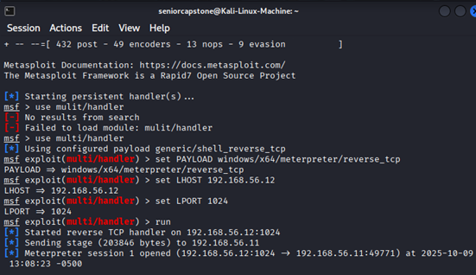
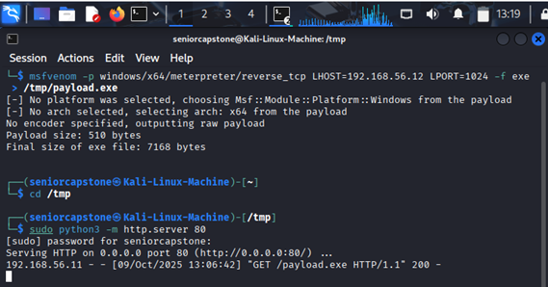
Stage 2: Obtaining Remote Access
Using multi/handler as a listener
Sending malicious payload to victim as a http address
CS
Notes:
Stage Two: This leads to our second stage of the attack where we deploy a malicious payload using the Metasploit framework to gain direct remote access to the target machine. This was done through setting up multi-handler to act as a listener, which waited for the target machine to connect back and establish a reverse shell. To establish this reverse shell, we first logged in as user Hamza who has administrator privileges, and then we sent a malicious payload as a http address to the victim machine. (Daniel) (Slide 20)
Next Hamza slide 21 – ( partial 22 first Hamza then Daniel turn )

Slide 21
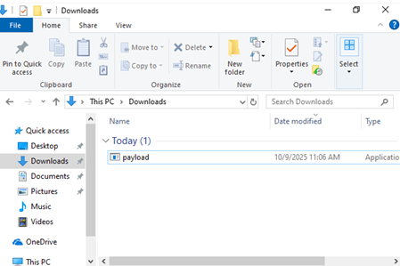

Stage 2: Obtaining Remote Access
Payload successfully downloaded
Payload executed
Remote access is granted
CS
Notes:
Stage Two: Entering that address resulted in the payload downloading onto the machine. Executing the file as user Hamza on the target machine established a reverse shell, as indicated by the newly opened Meterpreter session. (Hamza) (Slide 21)

Slide 22
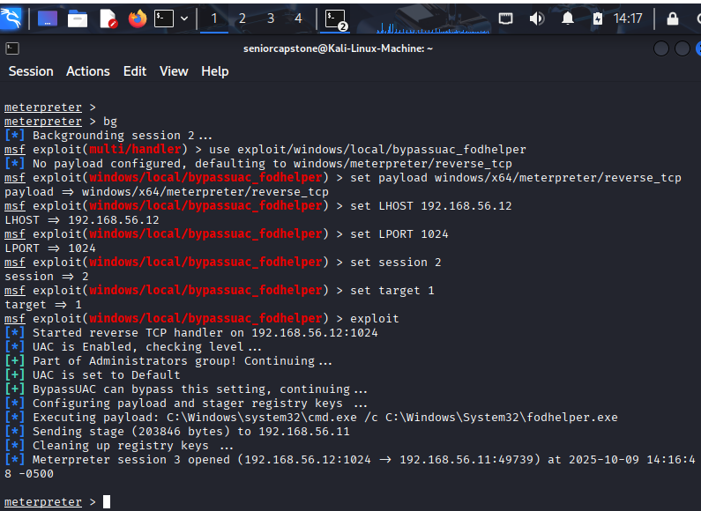
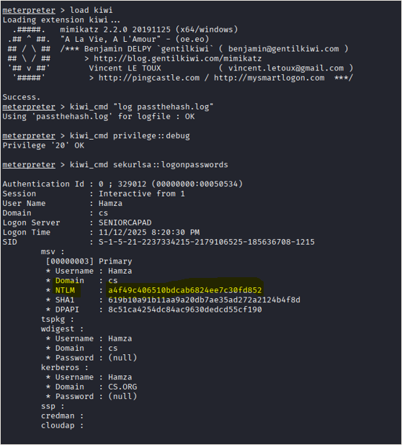
Stage 3: Compromising a NTLM Hash
Bypassing User Account Control
Privileges are now elevated
NTLM Hash is now acquired
CS
Notes:
Stage Three: Next we bypassed the User Account Control security function using the Metasploit framework. This was done through setting up the “bypassuac_fodhelper” exploit, and instructing our payload to manipulate the fodhelper.exe process into executing commands on an elevated Command Prompt, which elevated our privileges to a higher level on the established Meterpreter shell. We next ran the “net user” command on the shell to confirm that user Hamza is part of the domain admins group, and has administrator level privileges. (Hamza) (Slide 22)
Stage Three: We then loaded the Kiwi tool which has Mimikatz functionality to capture logon password hashes. Here we see that Hamza’s NTLM has was captured when running the privilege debug command and then running the command to reveal a log of all recently logged on users’ information. (Daniel) (Slide 22)

Slide 23
Stage 3: Compromising a NTLM Hash
Hash is passed
Attacker authenticated a new session as user Hamza
CS
Notes:
Stage Three: We then extracted Hamza’s NTLM password hash from that log, and passed it to the Domain Controller to authenticate a new session as user Hamza. (Daniel) (Slide 23)

Slide 24
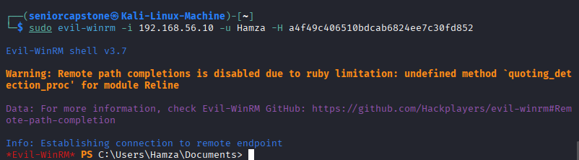
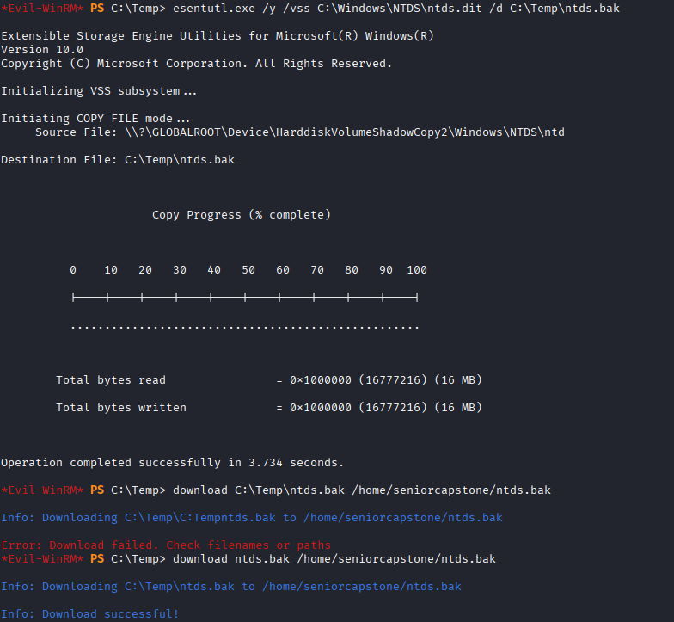
Stage 4: Compromising the Domain Controller
Connecting to Domain Controller via Evil-WinRM
Compromising ntds.dit and SYSTEM hive files by creating shadow copies
CS
Notes:
Stage Four: Now that we have confirmed that we can authenticate as user Hamza, we finally leveraged his NTLM hash to authenticate to the Domain Controller using Evil-WinRM. This will establish a remote session to the Domain Controller, where we have remote access to the server’s PowerShell. Since user Hamza is a domain administrator, he has access to all of the Domain Controller’s files, more specifically the NTDS.dit file that contains all of the Active Directory’s data, and the SYSTEM registry hive file which decrypts the contents in the NTDS.dit file. This allowed us to create shadow copies of both the NTDS.dit file and the SYSTEM registry hive file, and download them directly to our Kali Linux machine. (Daniel) (Slide 24)
Next Hamza slide 25

Slide 25
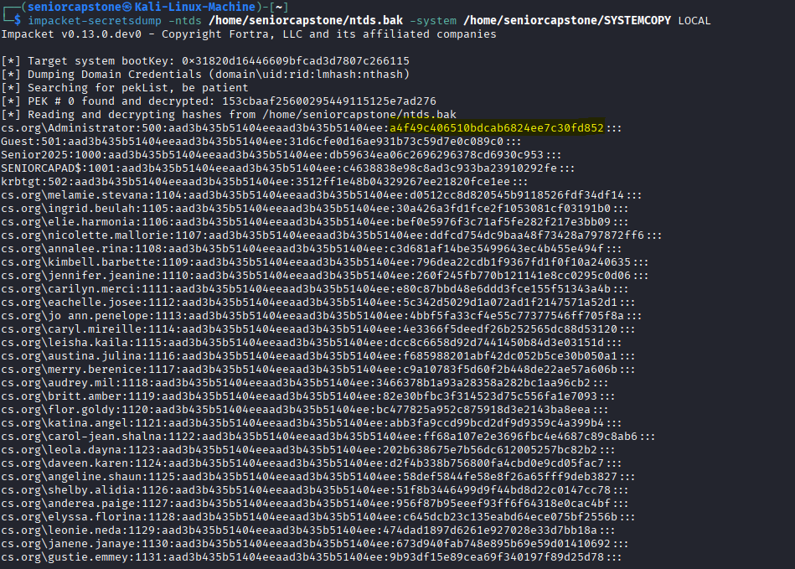
Stage 4: Compromising the Domain Controller
CS
Successfully compromised all domain user hashes
Notes:
Stage Four: Once we downloaded both files, we ran the “impacket-secretsdump” command to gather the encrypted data from the copy of our NTDS.dit file, and then decrypt them using the copy of our SYSTEM registry hive file. This then dumped all domain users credentials, and revealed every single user’s NTLM hash (Hamza) (Slide 25)

Slide 26
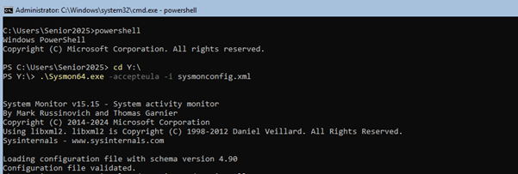
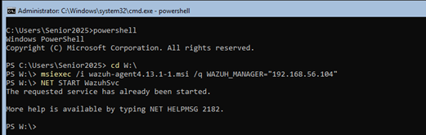
Methodology: detecting and alerting of attack behaviors
Install Sysmon with configuration file
Install Windows Wazuh agent endpoints
Notes:
So here I will discuss how we set up our detection pipeline, and how we created our custom rules to detect and alert of specific Pass-the-Hash attack behaviors. (Slide 26)
So first I installed Sysmon, along with the Olaf Hartong Sysmon configuration file on each Windows device. This configuration file is designed specifically to detect events related to a Pass-the-Hash attack such as process creations of the fodhelper and LSASS process, remote authentication events using an NTLM hash, and attempts to access the memory from the LSASS process. (Slide 26)
I then installed Wazuh agent endpoints on both Windows machines to forward logs to the Wazuh Manager. (Slide 26)

Slide 27
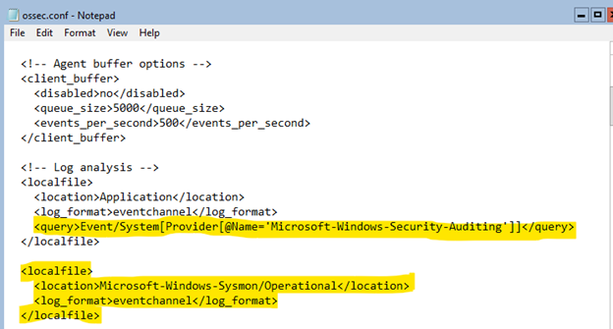
Methodology: detecting and alerting of attack behaviors
Configure Wazuh to collect logs from Sysmon and Windows Security Auditing System
Notes:
The Wazuh server is configured to collect event logs from Sysmon as well as to collect event logs from the Windows Security Auditing System. These logs will then be analyzed to generate alerts for each of our custom rules (Slide 27)

Slide 28
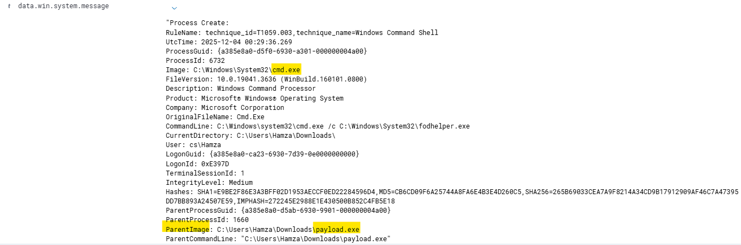
How atomic rules were configured
Based each rule from observed attack behaviors
Observed event data lines from triggered base Sysmon rules’ logs
Notes:
With our custom Wazuh rules, I first configured rules that will detect when a specific behavior of the attack occurs within the Active Directory. This was done through resimulating the attack, and observing which preconfigured base Sysmon rules are triggered. I then analyzed the most relevant rules’ event logs, and observed each event data line to determine the specific image, command line, or file that triggered that rule. As an example, we have the event log generated by base Sysmon rule 92052. This rule detects when the Command Prompt is abnormally opened by another process, and we can see here that the Image data line revealed that the cmd.exe process was executed by our malicious payload as seen here in the ParentImage data line. (Slide 28)

Slide 29
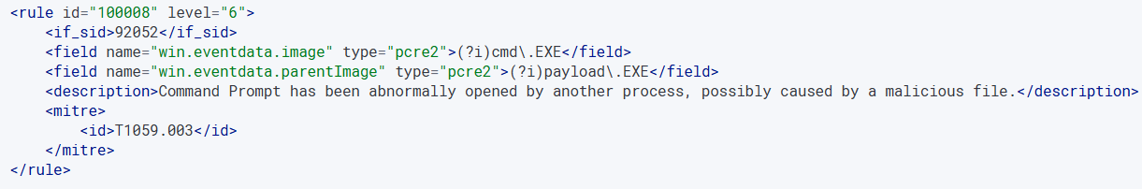
How atomic rules were configured
Custom rules uses image, command line, or file name event data to trigger
Linked to a base Sysmon rule to allow for custom rule to trigger
Notes:
These observed event data lines are then applied to our own custom rules to detect specific attack behaviors. As seen here, I applied the Image and ParentImage data fields to detect when the payload manipulates a process into executing the Command Prompt. Each of our custom rules are linked to a base Sysmon rule,. This is to override the alerts from the base Sysmon rules to instead display alerts from our custom rules. (Slide 29)

Slide 30
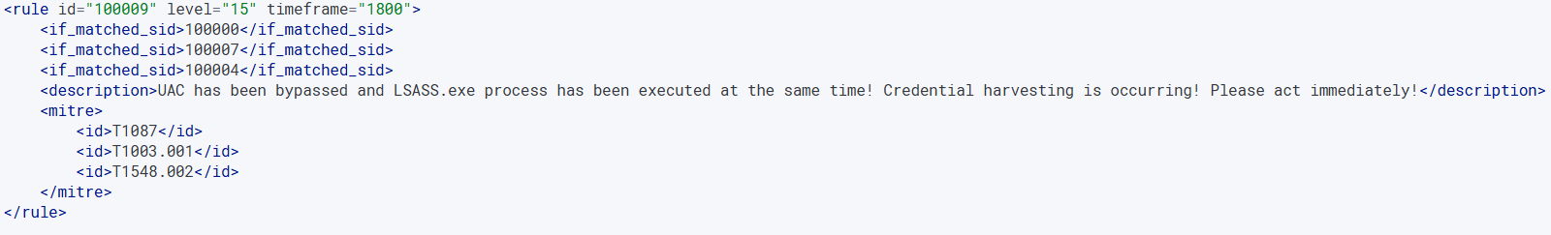
How correlation rules were configured
Combined atomic rules that often chain together
Based each rule from specific attack sequence
Notes:
I also configured a set of correlations rules that will detect and alert of specific attack steps and sequences we performed during our attack simulation. This was done through combining relevant atomic rules, and detecting when they are chained together within a thirty-minute time frame. As an example, to detect the full sequence that leads to credential harvesting, I combined these three atomic rules that detect specific behaviors that led to us extracting Hamza’s NTLM hash. When these three behaviors are chained together, it will generate an alert that will inform us of that specific attack sequence occurring within our network. (Slide 30)

Slide 31
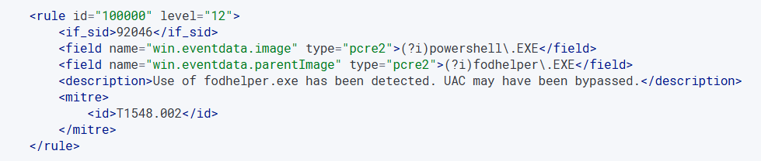
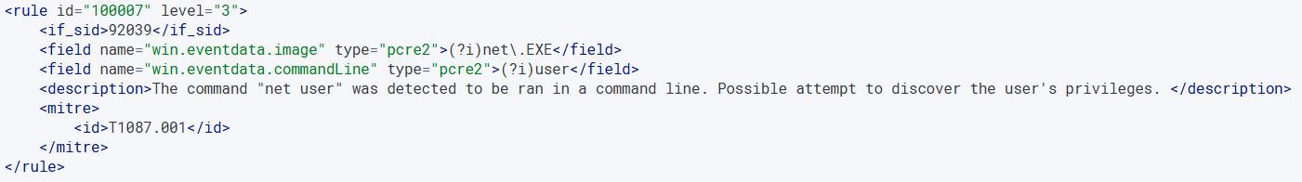
What each rule aims to detect
UAC bypass
User privilege reconnaissance
Notes:
I configured a total of nine atomic rules that detect specific attack behaviors. The first set of rules will detect behaviors related to credential extraction. Rule 0 will detect when the fodhelper process was created to bypass the User Account Control security feature. (Slide 31)
Rule 7 will detect when the “net user” command is run on the Windows shell. This aims to detect when an attacker performs reconnaissance to reveal user privileges and the domain groups the user is a part of. (Slide 31)

Slide 32
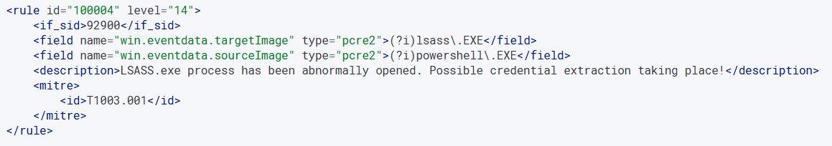
What each rule aims to detect
Credential extraction
Privilege escalation and account compromise sequence
Notes:
Rule 4 will detect when the LSASS process has been abnormally opened and accessed. This aims to detect the moment we extracted NTLM hashes from that process. (Slide 32)
Rule 9 is our first correlation rule, which will detect the full attack sequence we performed to achieve the end goal of extracting user Hamza’s NTLM hash. This will detect the chaining of events where we first bypassed the User Account Control, which leads to us performing reconnaissance to reveal user Hamza’s privileges, and finally leads to us accessing the LSASS process to extract his NTLM hash. (Slide 32)

Slide 33
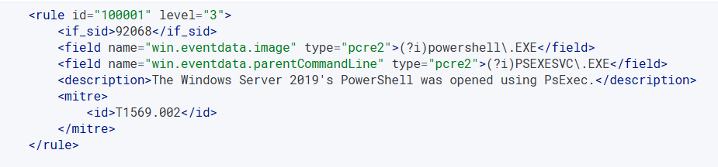
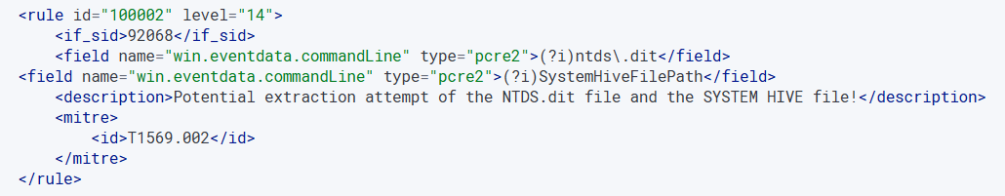
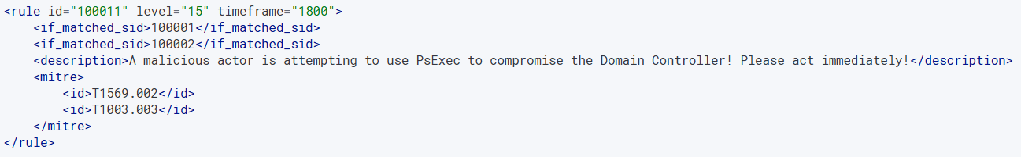
What each rule aims to detect
Standard PsExec execution
Domain Controller file extraction
Compromising Domain Controller using PsExec
Notes:
Our next set of rules will detect the use of the PsExec tool. In our first attempt of the attack simulation, we tried to extract the Domain Controller’s files through creating a remote session to the Domain Controller using the PsExec tool. However, our original attempt failed as we could not properly extract those files from the Domain Controller. Despite that, Sysmon was still able to detect our attempts to extract those files using the PsExec tool. (Slide 33)
Rule 1 will detect the standard execution of the PsExec tool, which creates a remote session of the Domain Controller’s PowerShell. (Slide 33)
Rule 2 will detect our attempts to extract the Domain Controller’s files. This will detect instances of the strings “ntds.dit” and “SystemHiveFilePath”, which were the commandlets we used in our attempt of extracting those files. (Slide 33)
Rule 11 is the correlation rule that detects the chaining of rules 1 and 2. This rule will specifically detect the full sequence when we executed the PsExec tool to attempt an extraction of the Domain Controller’s files. (Slide 33)

Slide 34
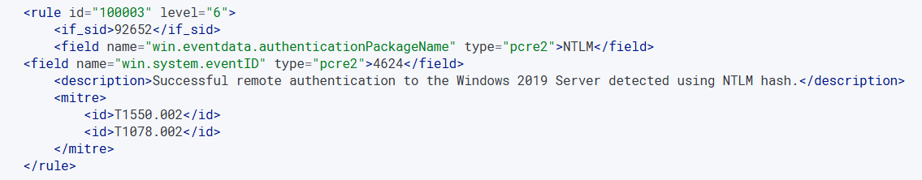
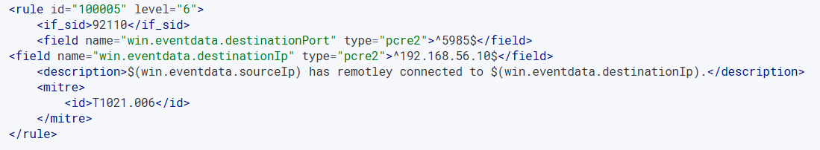
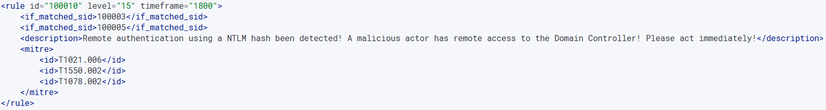
What each rule aims to detect
NTLM authentication
Remote connection using WinRM
Authenticating a remote session to the Domain Controller
Notes:
Since we used Evil-WinRM to extract the Domain Controller’s files, our next set of rules will detect when we authenticate a remote session from the Kali Linux machine to the Domain Controller. (Slide 34)
Rule 3 will detect when a user uses an NTLM hash to authenticate to the Domain Controller. (Slide 34)
Rule 5 will detect when a specific IP address uses the WinRM tool to create a remote session to the IP address of the Domain Controller. (Slide 34)
Rule 10 is the correlation rule that detects the chaining of rules 3 and 5. This rule will specifically detect the full sequence of authenticating a remote session to the Domain Controller using the Evil-WinRM tool, and user Hamza’s NTLM hash. (Slide 34)

Slide 35
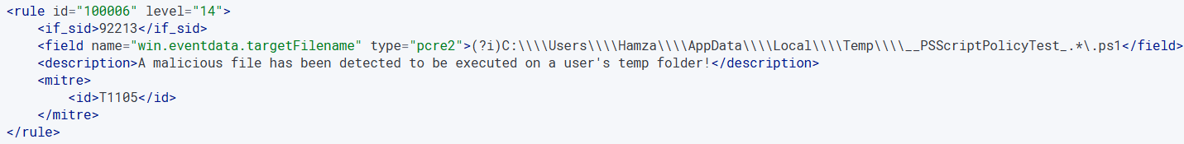
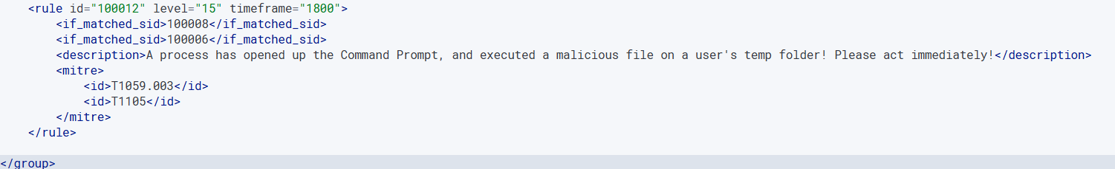
What each rule aims to detect
Execution of payload file
Malicious execution of the Command Prompt by processes
Process manipulation by the payload
Notes:
Finally, our last set of rules will detect the use of our malicious payload, and the actions it performs. Rule 6 will detect when the payload file has been executed to run PowerShell scripts on Hamza’s temp folder, and runs PowerShell scripts. (Slide 35)
Rule 8 will detect when the Command Prompt was abnormally opened by a process. It will specifically detect the malicious payload as the original source that created the processes, like fodhelper, that launched the Command Prompt to execute malicious commands that bypass security features, like the User Account Control. (Slide 35)
Rule 12 is the correlation rule that detects the chaining of rules 6 and 8. This will detect the full sequence of the payload being executed, and then the successful manipulation of processes that allowed us to remotely connect to the target machine and bypass the machine’s security features. (Slide 35)
Ok, now I will show a demonstration video of how our detection pipeline product works. Show demonstration video after presenting this slide (Slide 35).
Next Hamza slide 36 - 48

Slide 36
Methodology: mitigation of attack behaviors
Notes:
Speaker Notes: To mitigate Pass-the-Hash risk, we focused on reducing credential reuse exposure and strengthening authentication. First, we implemented Microsoft LAPS so that local administrator passwords are rotated automatically and stored securely in Active Directory. This prevents attackers from reusing a previously stolen hash during lateral movement.
Next, we enforced NTLMv2 authentication to improve protection against hash-based replay. We also reduced administrative privileges to minimize the ability for attackers to escalate. After applying these controls, we repeated the PtH attack and confirmed that the stolen hash could no longer be reused, demonstrating the effectiveness of these mitigation measures.

Slide 37
LAPS Implementation Process
CS

Slide 38
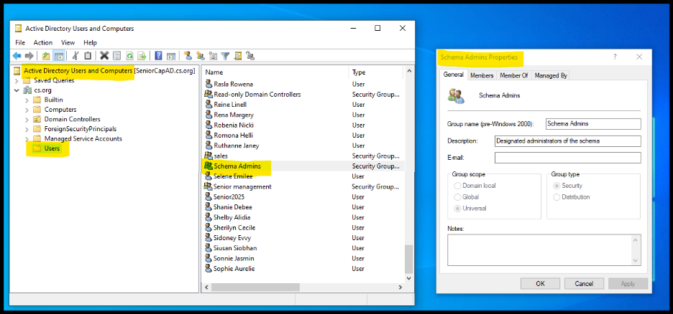
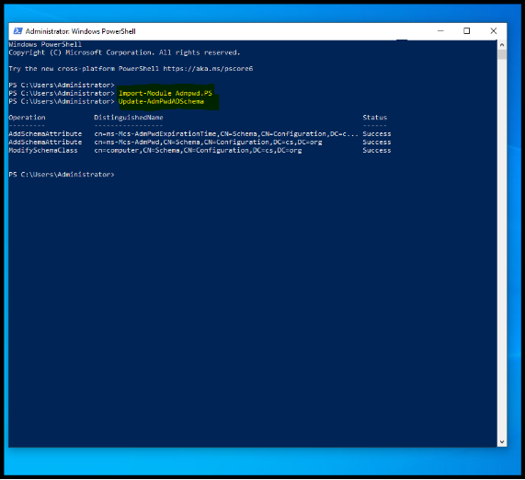
Verifying Schema Admin Privileges
Updating the Active Directory Schema for LAPS
CS

Slide 39
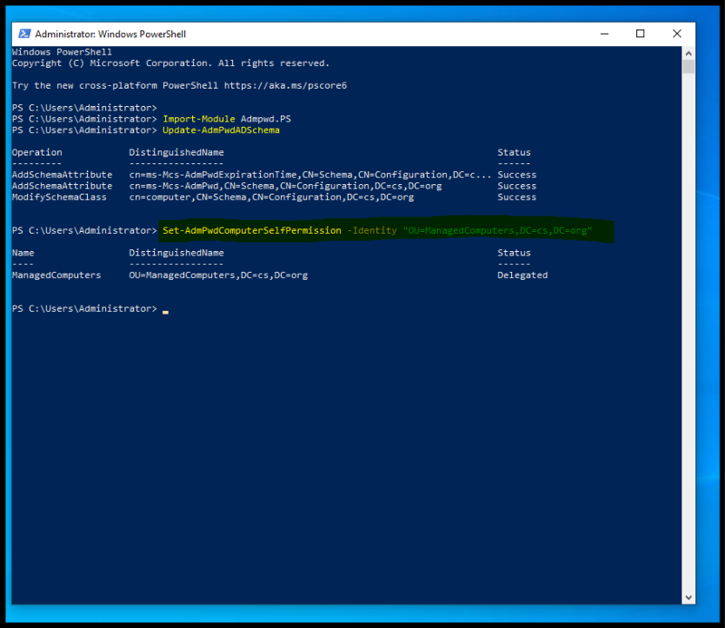
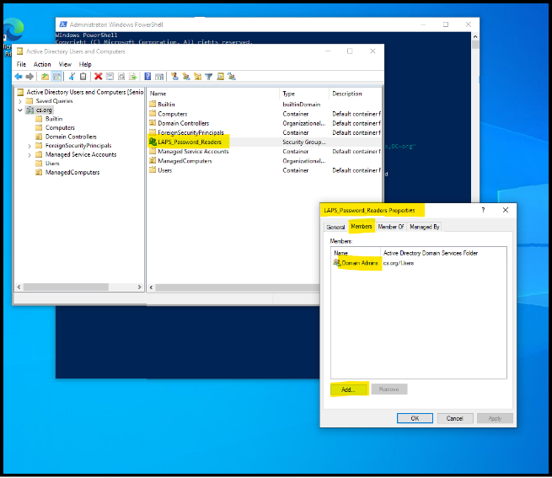
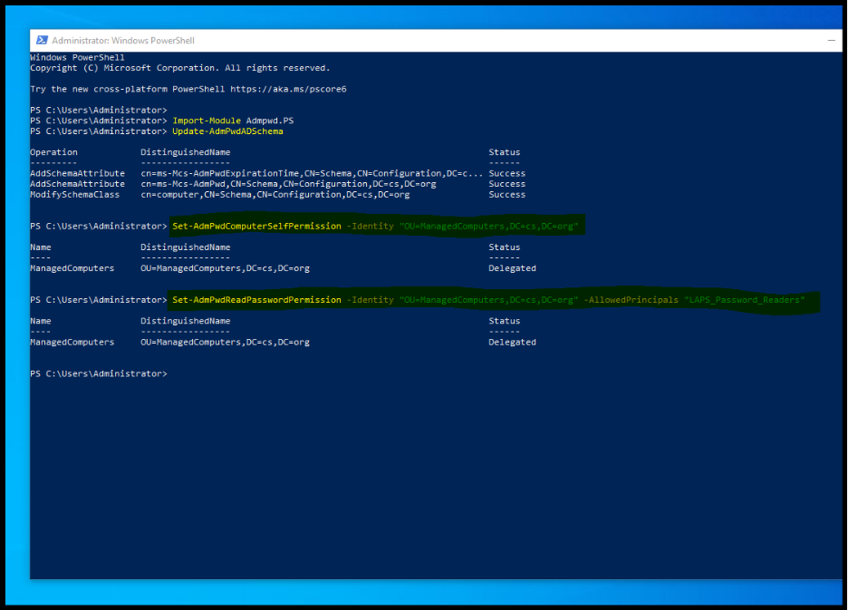
Delegating LAPS Permissions to Managed Computers
Verifying Schema Administrator Membership
Configuring Read Permissions for LAPS Password Retrieval (LAPS_Password_Readers Group)
CS

Slide 40
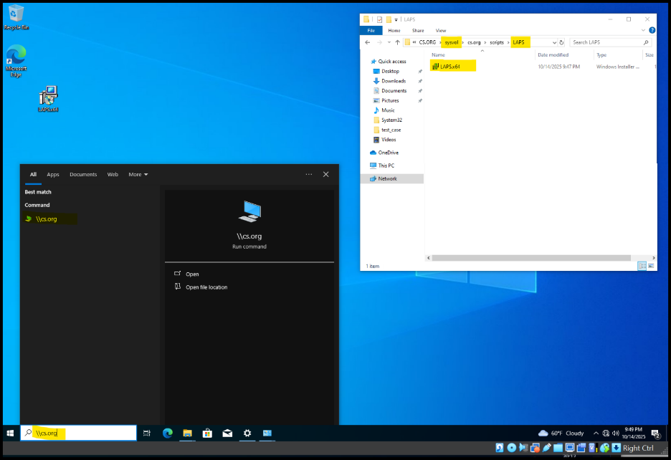

Installing LAPS Administrative Templates and Preparing the GPO
CS

Slide 41

Setting LAPS Password Length, Complexity, and Rotation Policy
CS

Slide 42



Linking the LAPS GPO and forcing Group Policy update on the target machine.
CS

Slide 43

Confirming Successful LAPS Deployment and Password Rotation
CS

Slide 44
NTLMv2 Implementation Process
CS

Slide 45

NTLMv2 Policy Verification
CS

Slide 46


NTLMv2 Policy Configuration in Group Policy
CS

Slide 47


Linking the NTLMv2 GPO to the Domain and Confirming Policy Application
CS

Slide 48

Forcing Group Policy Update to Apply NTLMv2 Settings
CS

Slide 49


Results of the detection pipeline
All atomic rules have been successfully triggered by attack’s behaviors
All correlation rules have been successfully triggered by chained events
SC
Notes:
We gathered and observed our results based on three test runs of the attack. (Slide 49)
All of our atomic rules successfully triggered when they detected the specific behaviors related to a Pass-the-Hash attack. As an example, we can see that an alert for rule 4 was generated when we accessed the LSASS process to extract Hamza’s NTLM hash. Additionally, our correlation rules successfully triggered when its relevant atomic rules are chained together. Here we can see an alert for rule 9 was generated when rules 0, 7, and 4 triggered together within a thirty-minute timeframe. (Slide 49)

Slide 50


detection pipeline Issue #1
Some rules triggered more than once
Resulted in some rules generating false positive alerts
SC
Notes:
However, our detection pipeline did encounter a few issues. The first issue is that some of our custom rules generated multiple false positives. As an example, each time we started up both Windows machines, rule 7 would generate seven false positive alerts, due to the Wazuh agent endpoints running variations of the “net user” command. Another example would be rules 3, 5, and 10, where it generated a false positive alert each time we exited the remote session. This confirms that some of our rules need fine tuning to exclude events generated by normal system and user activity. (Slide 50)

Slide 51


detection pipeline Issue #2
Green = First test run. Orange = Second test run.
Correlation rules only trigger when last correlated rule triggers twice
Resulted in some rules not triggering at all (false negatives)
SC
Notes:
The second issue we encountered was that our correlations rules required the last rule in the chain to be fired twice. When running the first test run, all atomic rules related to that correlation rule will generate an alert. However, an alert for the correlation rule will not generate during the first test run. Instead it will generate an alert in the second run when the last rule in the chain is fired a second time. As an example, we can see that rule 9’s atomic rules all generated alerts in the first test run, but did not generate an alert for rule 9. It is not until we performed a second test run of rule 4, is when an alert for rule 9 is generated. This resulted in many false negative alerts as not only the first alert for each of the correlation rules are not generated, but each sequential test run of the last chained rule will be suppressed, as an alert for the correlation rule will take its place. As an example, when doing a second test run of rules 1, 2, and 11, rule 11 will generate an alert, but no alert for rule 2 will be generated. (Slide 51)
Next Hamza slide 52 - 56

Slide 52
Results of the mitigation practices
SC
Notes:
Speaker Notes:
Once mitigation controls were implemented, we re-tested the Pass-the-Hash attack. Because LAPS rotates the local administrator password and stores it securely in Active Directory, the previously stolen hash was no longer valid when the attacker attempted to reuse it. Additionally, enforcing NTLMv2 strengthened authentication and reduced opportunities for hash replay. As a result, PsExec and Evil-WinRM attempts failed, significantly reducing the attacker’s ability to move laterally. These results demonstrated that combining credential rotation with stronger authentication policies is effective at minimizing PtH impact in Active Directory environments.

Slide 53
Outcomes of LAPS Deployment
CS

Slide 54

LAPS Password Rotation Result
CS

Slide 55
NTLMv2 Impact on Pass-the-Hash Attack Success
CS

Slide 56


Validating NTLMv2 Logon Events (Event ID 4624)
CS

Slide 57



How our work can be applied by others
Cost effective products for detecting and mitigating PtH attacks
Useful guides to implement PtH attack detection and mitigation products
Adaptable for penetration testing and response training
Image Sources: freepik.com, dreamstime.com
Notes:
So first our attack simulation research can be used as a blueprint for organizations to perform network penetration tests of their networks through simulating PtH attacks safely. This is to evaluate the effectiveness of their current network security measures in detecting and mitigating Pass-the-Hash attack behaviors. (Cost effective products for detecting and mitigating PtH attacks) (Daniel)
If it is discovered that their current security measures are not effective in preventing Pass-the-Hash attacks, then our products can be used as a low-cost, open-source solution that can be practically implemented in any small or medium-sized Active Directory environment to effectively prevent Pass-the-Hash attacks. (Cost effective products for detecting and mitigating PtH attacks) (Hamza)
Next our products can be effectively used as guides on how to implement a detection pipeline and mitigation solution into an Active Directory environment. Our detection product provides specific examples of how to set up Sysmon and Wazuh on Windows machines to analyze event logs and generate alerts. We also provided many specific examples of Wazuh rules that are designed to alert of detected Pass-the-Hash attack behaviors. Additionally, the detection pipeline can be applied to detect other credential stealing attacks like a Pass-the-Ticket attack or an NTLM relay attack. (Useful guides to implement PtH attack detection and mitigation products) (Daniel)
Guides implementation of practical AD hardening controls (Cost effective products for detecting and mitigating PtH attacks ) (Hamza)
Finally, our products can be integrated into Security Operations Center (SOC) playbooks for credential-attack testing. This can lead to the development of incident response plans that train cybersecurity professionals on the immediate steps required to contain a live Pass-the-Hash attack when it is detected on a Wazuh server. (Adaptable for penetration testing and response training) (Daniel)
This includes isolating the affected network sectors to contain the threat, eradicating the threat, and applying mitigation tools to secure the Domain Controller and all domain machines by enforcing principles like Local Administrator Password Solution (LAPS). (Adaptable for penetration testing and response training) (Hamza)
.

Slide 58
conclusion
Pass-the-Hash attacks remain as a stealthy, but high-impact threat to Active Directory environments
Sysmon + Wazuh successfully detected and alerted of Pass-the-Hash attack behaviors in real time
LAPS + NTLMv2 reduced or blocked credential-reuse attempts
Thank you for listening!
Notes:
In conclusion, Pass-the-Hash attacks remain as a stealthy, but high-impact threat to Active Directory environments. Pass-the-Hash attacks are hard to counter and detect, as it can disguise itself as a normal user authenticating to the domain. (Daniel)
To counter this attack, we first employed Sysmon and Wazuh to detect and alert of Pass-the-Hash attack behaviors in real time. This resulted in our rules successfully detecting our observed attack behaviors, however some of our rules need additional fine tuning to reduce false positive and false negative alerts. (Daniel)
LAPS and NTLMv2 played a key role in reducing or blocking credential-reuse attempts. These measures significantly reduced the ability for attackers to reuse stolen credentials, thus strengthening the security of our Active Directory environment. (Hamza)

Slide 59
Questions?
Notes:
“Any questions?” (Hamza will say this at the end).
Notes: 1) Why did you choose Pass-the-Hash as your attack focus?
Pass-the-Hash is among the most common credential-theft and lateral-movement techniques used against AD environments. It requires only stolen hashes, not passwords, making it efficient and dangerous. It maps to MITRE ATT&CK T1550.002, which emphasizes its relevance.
2) Why did you use Sysmon instead of default Windows logs?
Default logs provide limited detail; Sysmon offers rich telemetry such as process creation, network connections, and credential access events, which made detecting PtH behaviors more effective.
3) Why did you choose Wazuh?
Wazuh integrates SIEM features, log parsing, and alerting in a free platform. It can scale easily and provides strong rule customization, which allowed us to create PtH-specific detection rules.
4) What event IDs were most useful?
Sysmon Event ID 1 – New process created
Sysmon Event ID 3 – Network connection detected
Sysmon Event ID 10 – Credential access
Windows 4624 – Successful account logon
These are strong indicators of lateral movement and attempted PtH activity.
5) What tools did you use to perform PtH?
We used Mimikatz to extract the NTLM hash, and PsExec/Evil-WinRM to authenticate using the stolen hash without requiring a password.
6) How does LAPS help prevent Pass-the-Hash?
LAPS rotates local admin passwords regularly. When passwords change, old hashes are invalidated, preventing attackers from reusing credentials they previously captured.
7) Why does NTLMv2 matter?
NTLMv2 improves credential protection and reduces the risk of replay attacks compared to earlier NTLM. Enforcing NTLMv2 makes hash-reuse more difficult and increases attacker effort.
8) Did your mitigation fully stop the attack?
It significantly reduced effectiveness. After LAPS rotation + NTLMv2 enforcement, attackers could no longer reuse previously captured hashes to access targets successfully.
9) What would be your next steps / future work?
Expand to detect other credential-theft techniques (over-pass-the-hash, Kerberoasting)
Integrate additional SIEM solutions
Automate alerts + response playbooks
Apply more granular least-privilege policies
10) What was the biggest challenge?
Tuning the detection rules to avoid false positives while still identifying relevant PtH activity. Configuring Sysmon + Wazuh properly was essential.
For scalability
The same detection + mitigation pairing can scale across enterprise environments by deploying Sysmon through GPO, centralizing collection with Wazuh/SIEM, and enforcing LAPS + NTLMv2 on all hosts. This makes the approach realistic and practical.

Slide 60
References
Stouffer, C. (2023, June 22). What is a pass the hash attack? + How to mitigate an attack. Norton. https://us.norton.com/blog/emerging-threats/pass-the-hash
Chalot, A. & Seigneuret, T. (2023, March 31). Protected Users: you thought you were safe uh? SensePost. https://sensepost.com/blog/2023/protected-users-you-thought-you-were-safe-uh/
Elnagar, Z. (2024, February 13). Active Directory Basics. Medium. https://medium.com/@zm8870672/active-directory-basics-4482385122fd
IONOS. (2023, February 22). NTLM (NT LAN Manager). IONOS DigitalGuide. https://www.ionos.com/digitalguide/server/know-how/ntlm-nt-lan-manager/
Huawei. (2025, September 19). AI in banking moves past pilots: But hyper-personalized services and engineering will determine the winners. Huawei. https://e.huawei.com/ua/events/branding/huawei-connect/2025/ai-in-banking
[Vector illustration of a user manual/guide book] (n.d.). Dreamstime. https://www.dreamstime.com/user-manual-guide-book-vector-illustration-guidance-information-tutorial-support-advice-instruction-document-flat-guidebook-image194237726

